Slide 1
INTRODUCTION TO DATA SCIENCE | MID-TERM
Dataset at a Glance
9,742
100,836
610
Movie Rating &
User Preference
Analysis
Total Movies
Total Ratings
Unique Users
Project Objectives
Analyze movie ratings & genre popularity
Explore user preference patterns
Visualize key insights from MovieLens
Using MovieLens 100K Dataset
Support a simple recommendation approach
Kaggle
MovieLens
100K Ratings
Python

Slide 2
Project Overview & Analysis Flow
ANALYSIS PIPELINE
1
Data Cleaning
>
2
Data Transformation
>
3
EDA
>
4
Data Visualization
>
5
Findings / Insights
What We Analyze (EDA & Visualization)
Dataset Files
Rating distribution — overall rating behaviour
movies.csv
Most rated movies — movie popularity
9,742 movies | 3 columns
User activity — ratings contributed per user
movieId, title, genres
Movie distribution by genre — content representation
Ratings by genre — genre-level engagement
ratings.csv
100,836 ratings | 4 columns
userId, movieId, rating, timestamp
Ratings: 0.5–5.0 | Mean: 3.50
Movie Rating & User Preference Analysis | MovieLens 100K
2 / 11

Slide 3
Dataset Overview
Data Cleaning & Transformation – MovieLens 100K
9,742
100,836
610
3.50
Total Movies
Total Ratings
Unique Users
Average Rating
No Missing Values
No Duplicates
No Duplicate User-Movie Pairs
Year Feature Extracted
Genres Exploded per Row
movies.csv – Structure
ratings.csv – Structure
movieId int64 – Movie identifier
userId int64 – User identifier
title string – Movie title with year
movieId int64 – Movie identifier
genres string – Pipe-separated genres
rating float64 – Score (0.5 – 5.0)
timestamp int64 – Unix timestamp
9,742 rows | 3 columns | No nulls
100,836 rows | 4 columns | No nulls
Transformations applied:
Year extracted from title via regex
Rating distribution:
Genres split into individual rows
4.0 is most frequent (26,818 ratings)
Mean=3.50 Std=1.04 Min=0.5 Max=5.0
Movie Rating & User Preference Analysis | MovieLens 100K
3 / 11

Slide 4
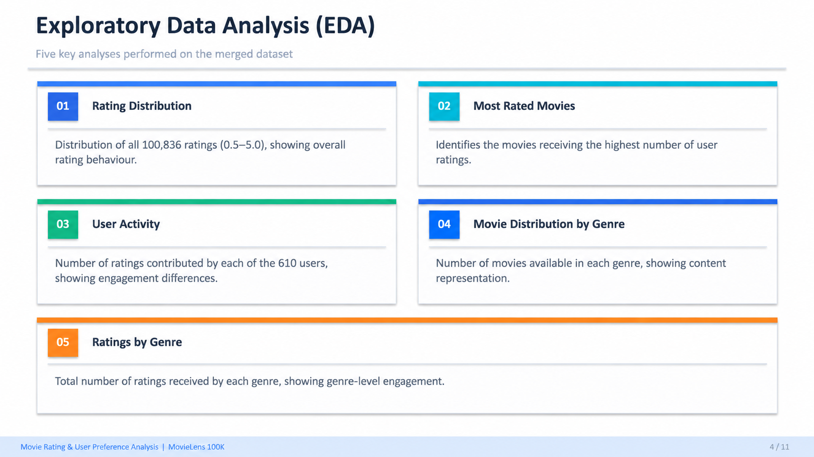

Slide 5
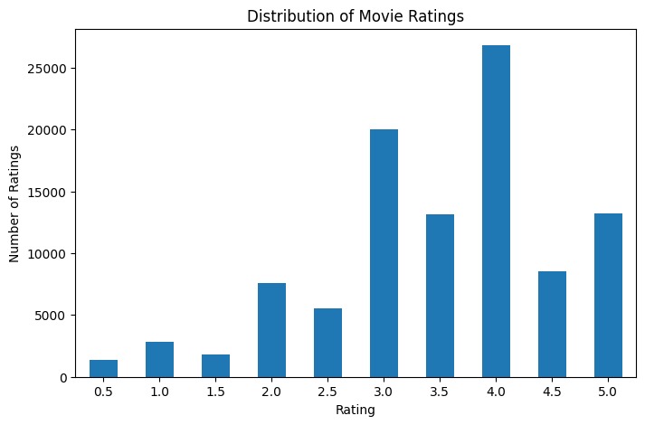
Distribution of Movie Ratings
EDA
EDA – How 610 users distribute 100,836 ratings across the 0.5–5.0 scale
Key Insights
4.0 is the most common rating
(26,818 occurrences)
3.0 and 3.5 are second and
third most frequent
Ratings below 2.0 are relatively uncommon, indicating that ratings are concentrated toward moderate-to-high scores.
Mean = 3.50 | Std = 1.04
Distribution peaks at 3.5–4.0
Movie Rating & User Preference Analysis | MovieLens 100K
5 / 11

Slide 6
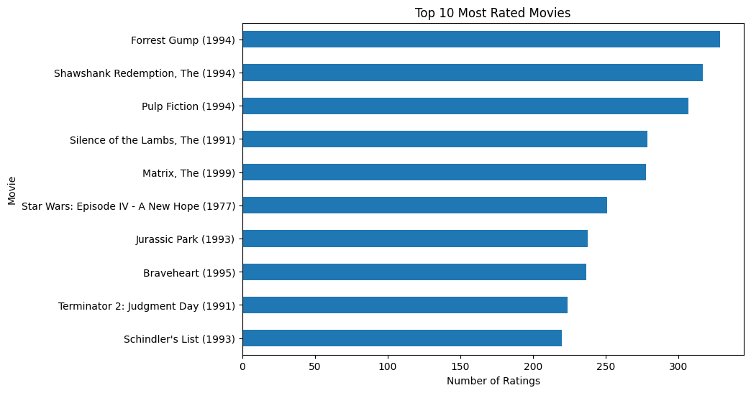
Most Rated Movies
EDA
EDA – Most frequently rated movies in the dataset
Key Insights
Forrest Gump receives the highest number of ratings.
The Shawshank Redemption and Pulp Fiction are also among the most frequently rated movies.
Several popular titles receive more than 250 user ratings.
User attention is concentrated around a relatively small group of highly popular movies.
Movie Rating & User Preference Analysis | MovieLens 100K
6 / 11

Slide 7
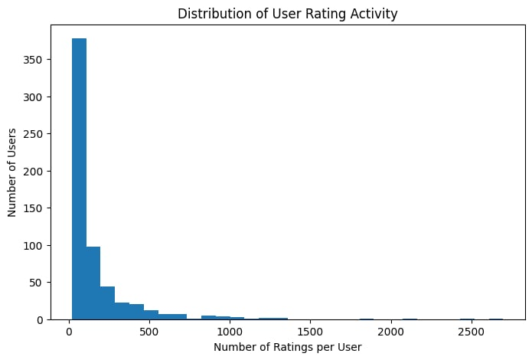
User Activity Distribution
EDA
EDA – Understanding user engagement patterns across the dataset
Key Insight
The distribution is strongly right-skewed.
Most users contribute relatively few ratings, while a few highly active users contribute much more.
Highly active users provide richer preference information than less active users.
Movie Rating & User Preference Analysis | MovieLens 100K
7 / 11

Slide 8
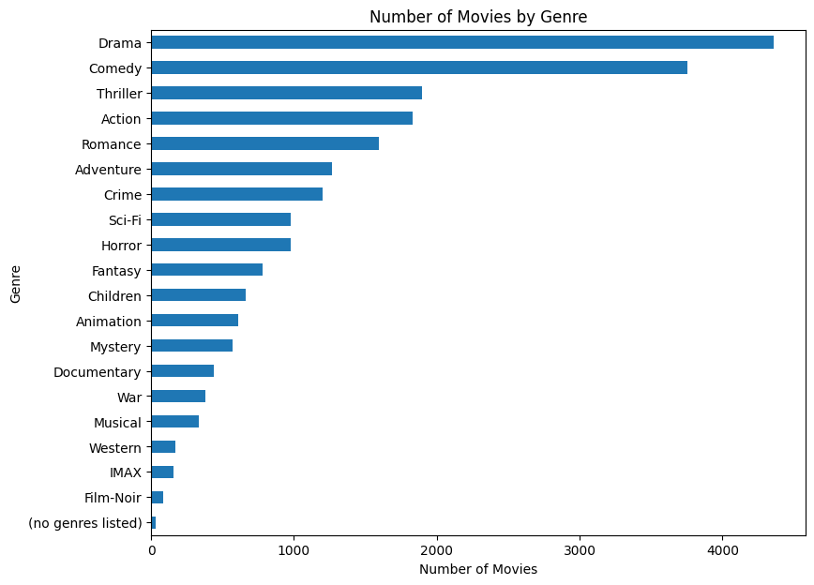
Movie Distribution by Genre
VISUALIZATION
Visualization – number of movies available in each genre
Key Insights
Drama contains the largest number of movies in the dataset.
Comedy is the second most represented genre.
Thriller, Action, and Romance are also strongly represented.
Genres such as Film-Noir, IMAX, and Western contain far fewer movies.
Movie availability is unevenly distributed across genres.
Movie Rating & User Preference Analysis | MovieLens 100K
8 / 11

Slide 9
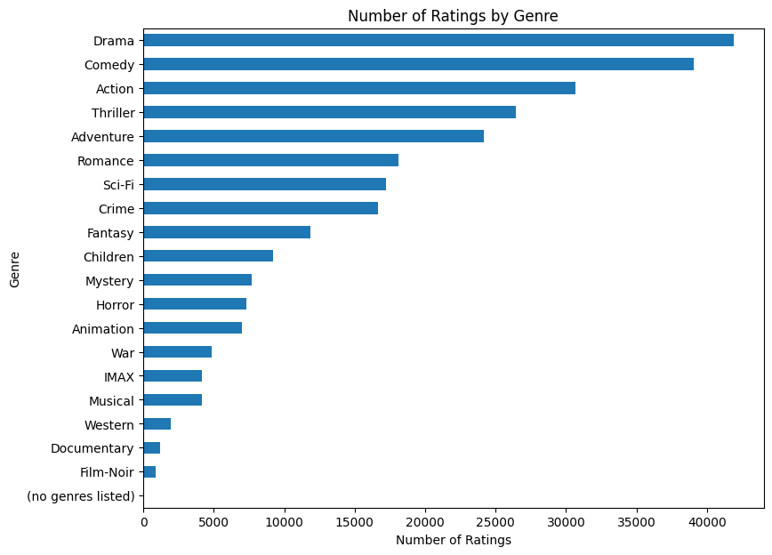
Number of Ratings by Genre
VISUALIZATION
Visualization – Genre popularity by total rating count
Key Insights
Drama & Comedy dominate by
total rating volume
Action, Thriller, Sci-Fi are
heavily reviewed genres
Some genres receive substantially more ratings than others.
User interaction is unevenly distributed across genres.
Genres with more available movies also tend to receive more ratings, although the level of engagement is not identical across genres.
Movie Rating & User Preference Analysis | MovieLens 100K
9 / 11

Slide 10
Findings & Insights
Key discoveries from EDA and Data Visualization
Rating Behaviour
Movie Popularity
Users tend to give moderate-to-high ratings, with an average rating of about 3.5/5. Very low ratings are relatively uncommon.
A small group of movies receives substantially more ratings than others, showing that user attention is concentrated on several highly popular titles.
Genre Representation
Genre Engagement
The number of movies varies significantly across genres, indicating an uneven distribution of content in the dataset.
Some genres receive considerably more ratings than others, suggesting different levels of user interaction across genres.
User Activity
User rating activity is highly uneven: most users contribute relatively few ratings, while a small number of highly active users contribute much more.
Movie Rating & User Preference Analysis | MovieLens 100K
10 / 11

Slide 11
Conclusion
What we learned – and what comes next
Summary of Findings
Data Quality: No missing values, no duplicates – the dataset is clean and ready for modeling.
Rating Insight: Ratings are concentrated toward moderate-to-high scores, with an average rating of about 3.5/5
Genre Insight: Movie availability and user rating activity are unevenly distributed across genres.
User Insight: User activity is highly uneven, with a small group of highly active users contributing much more rating information.
Visualization: EDA reveals clear patterns in rating behaviour, movie popularity, user activity and genre engagement.
Coming up in the Final Project
→ Feature Engineering | K-Means Clustering | Determine Optimal K
→ Analyze User Cluster Characteristics | Model Evaluation
→ Personalized Movie Recommendations based on cluster preferences
Movie Rating & User Preference Analysis | MovieLens 100K
11 / 11

